Slide 1
Save the world

Slide 2
storm is coming
1 run
2 stay and fight
fight

Slide 4
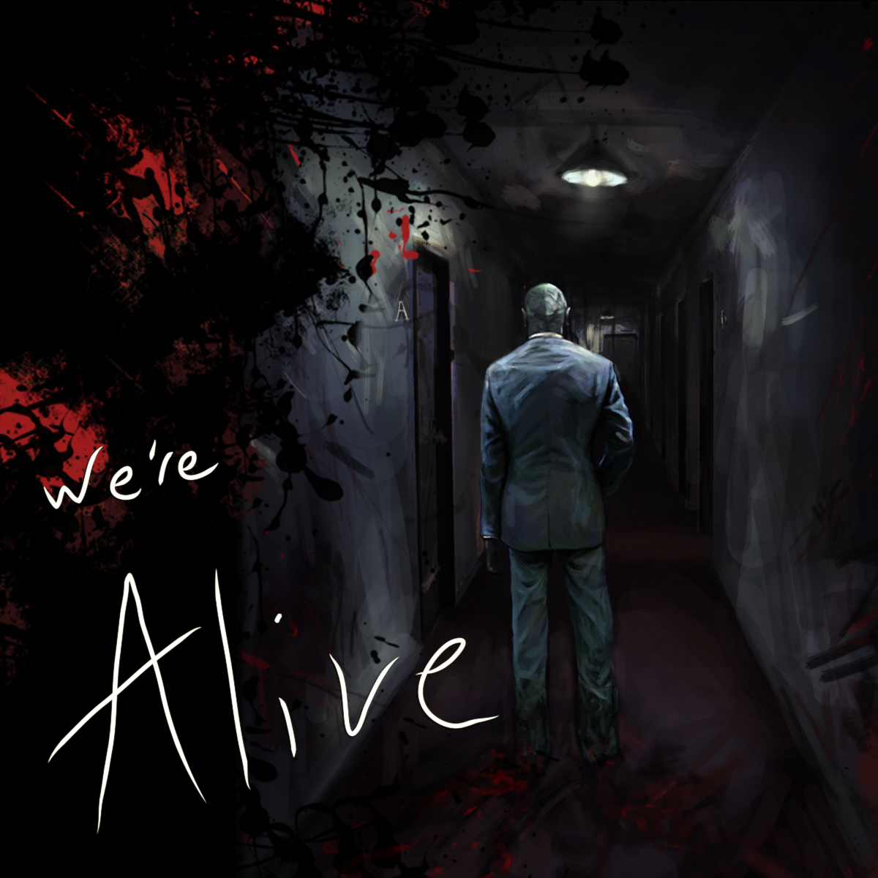
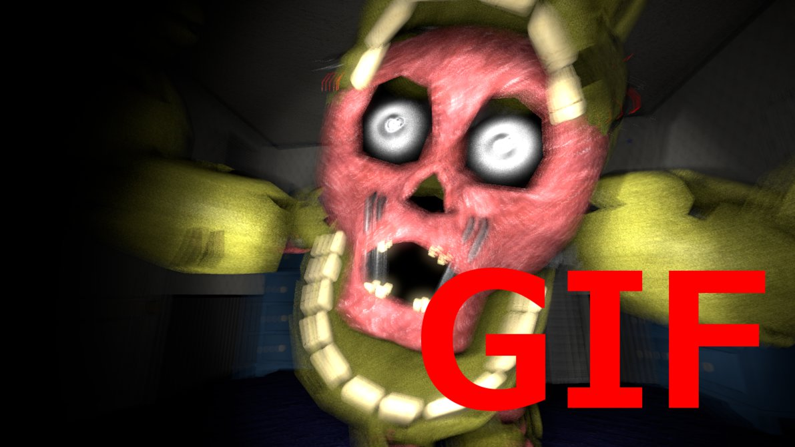
Wow you are still a live

Slide 5
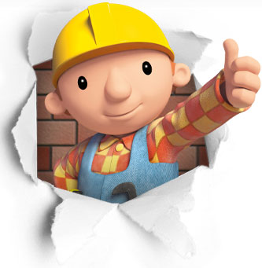
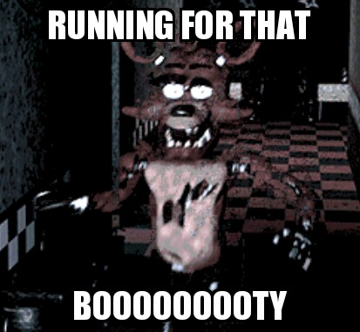
You die wow grat jjjjjjjjjjoooooooooob

