Slide 1
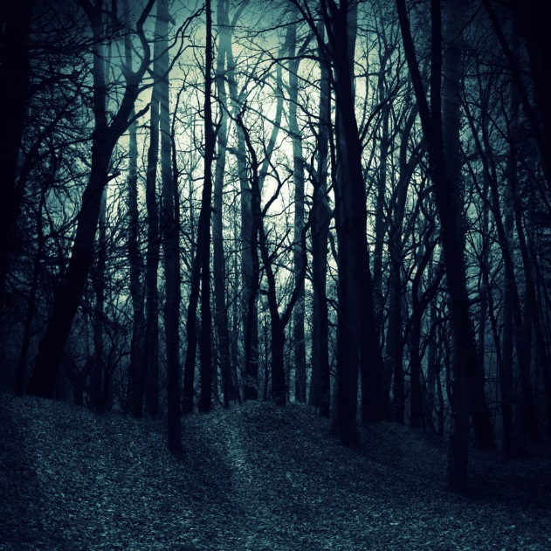
Into the Woods
By Zoe Pena

Slide 2
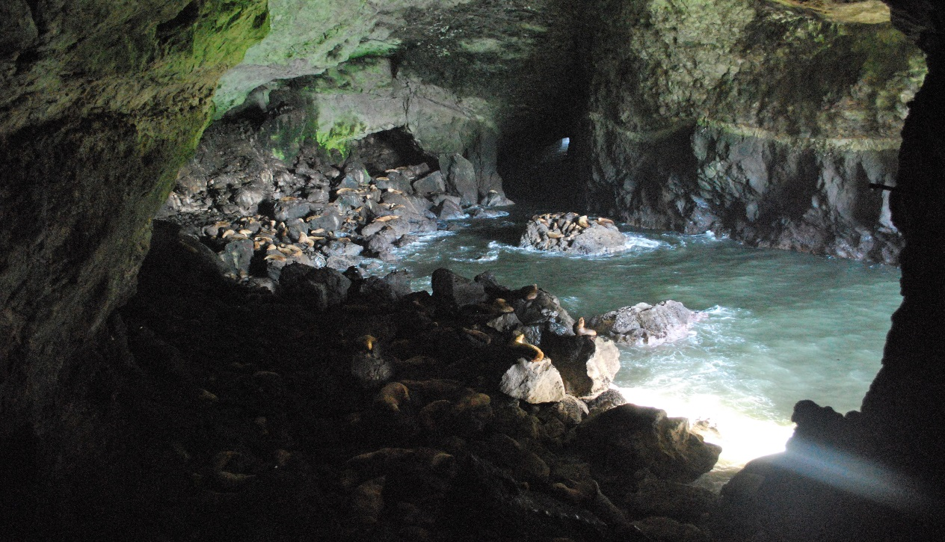
The story begins
On the night of Friday 13th your family was driving to a camp site on the way there they car broke down. You decide to go into the woods. You hear something in the in the bushes. You keep on exploring father and father. You come upon a dark and scary cave.
Go into the cave
Keep on exploring

Slide 3
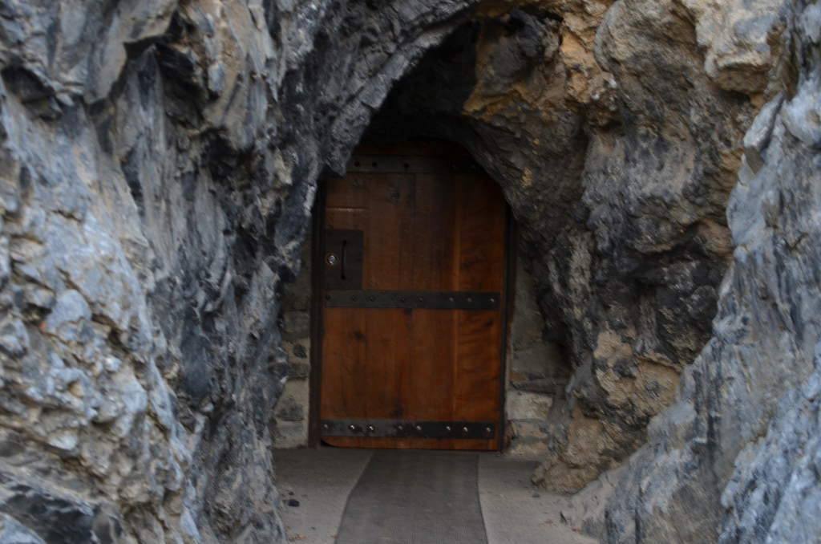
You go into the cave suddenly it gets cold and darker. You see a shadow on the wall when your turning you get really scared. You hear a big boom you turn around and see the cave door shut. You turn the corner of the cave. You see a bed and a oven and the oven is on. In the oven is an muffin. Your heart starts beating really fast.
You open the oven and eat the muffin
You explore even more

Slide 4
You get captured by aliens and have to work for them forever.
You loose

Slide 5
The muffin was posies
You die

Slide 6
You see light and you walk towed it, you see the sun your out of the cave. You still wonder what that shadow was…
YOU WIN!!!

